Slide 1
Technocrats Institute of Technology (Excellence), Bhopal
ELECTRONIC MEASUREMENT INSTRUMENTATION (EC-302)
Unit 1
Session – 1/6
Electronics & Communication Engineering
III
Dr. Jitendra P S Mathur, AP, EC, TIT
Technocrats Institute of Technology, Bhopal - 462021 MP, India
Phone : +91-755-2751679
e-mail: info@titbhopal.net | website: www.titbhopal.net

Slide 2
Technocrats Institute of Technology (Excellence), Bhopal
Measurement: Introduction
It is the process by which one quantity for measurement is converted in to physical parameters to meaningful or numerical numbers.
The measuring process is defined as the property of an object or system under consideration is compared to an accepted standard unit.
Example: Measurement of length using Vernier Callipers and measurement of diameter of wire using screw gauge.
Technocrats Institute of Technology, Bhopal

Slide 3
Technocrats Institute of Technology (Excellence), Bhopal
Characteristics of Instruments and Measurement systems
It shows the performance of instruments to be used.
There are two types:
(1) Static characteristics: Changes slowly with time or do not vary with time.
Example: Accuracy, Linearity, Sensitivity, Resolution etc.
(2) Dynamic characteristics: If measurements are concerned with rapidly varying quantity, then comparison between instrument output and ideal output when the input changes with time is defined in terms of dynamic characteristics of Instruments.
Example: Speed of response, fidelity, overshoot etc.

Slide 4
Technocrats Institute of Technology (Excellence), Bhopal
Accuracy: It is the closeness of measurement (or set of observations) to the true value.
Higher the accuracy create lower error in measurement.
E=Measured value-True Value
or System output- System input
Accuracy is expressed in the “percentage of full-scale reading”. In the case of instruments having a uniform scale, the accuracy can be expressed as “Percentage of Full-scale reading.

Slide 5
Technocrats Institute of Technology (Excellence), Bhopal
Precision is the degree of exactness for which the instrument is designed.
It composed of two characteristics: conformity and significant figures.
Sensitivity: Sensitivity can also be derived as for the smallest changes in the measured variable for which the instrument responds.
Sensitivity can be defined as the ratio of a change in output to change in input which causes it, in steady-state conditions.
Linearity: In that case, the output is linearly proportional with input.
It is represented by instrument calibration curve, if it is not a straight line that not be concluded that instrument is inaccurate.
Example: Resistance used in a potentiometer should vary linearly with displacement.

Slide 6
Technocrats Institute of Technology (Excellence), Bhopal
Resolution: If the input is slowly increased from some arbitrary (non-zero) input value, it will again be found that output does not change at all until a certain increment is exceeded.
It defines the smallest measurable input change while the threshold defines the smallest measurable input.
Dynamic Response: It is the rapidity with which an instrument responds to change in the measured quantity.
Fidelity: It is defined as the ability of the system to reproduce the output in the same from the input.
Dynamic error: It is the difference between the true value of the quantity changing with time.

Slide 7
Technocrats Institute of Technology (Excellence), Bhopal
DC and AC Ammeter
Electronic Measuring Instrument as Voltmeters, ammeters, and ohmmeters use amplifiers, rectifiers and other circuits to produce a current proportional to the quantity being measured. It is measured by PMMC instrument.
DC and AC Ammeter are mainly PMMC Analog instrument.
DC Ammeters use current through a moving or a fixed coil, to magnetically-attract a ferrous indicator, pulling against a centering-spring, to indicate the strength and the direction of the current’s flow.
AC Ammeters can use the force generated by a solenoid that has a aluminum plunger, as it is direct-proportionately-repelled by the amount of current through the coil.

Slide 8
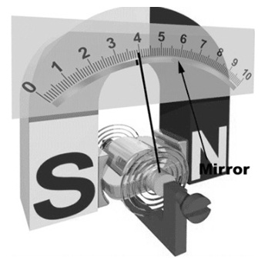
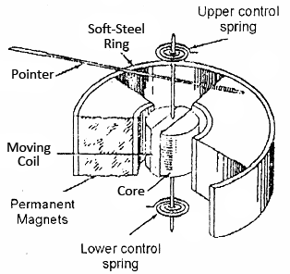
Technocrats Institute of Technology (Excellence), Bhopal
Diagram of PMMC Instrument

Slide 9
Technocrats Institute of Technology (Excellence), Bhopal
Working of PMMC Instrument
Apart from PMMC, it is also called as D’alvanometer. It is a kind of galvanometer that works on the principle of D’Arsonval.
These instruments use permanent magnets to create the stationary magnetic field in the coils, and then it is used with the moving coil that is connected to the electric source for generating deflection torque according to the Fleming left-hand rule theory.
After that the magnetic field will be in the forefinger, flow of current will be across the middle finger and finally, the force will be through the thumb finger.

Slide 10
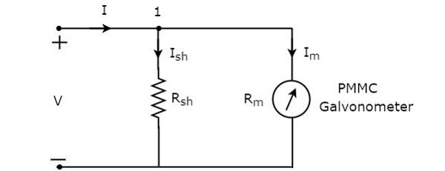
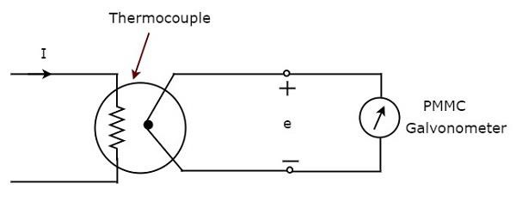
Technocrats Institute of Technology (Excellence), Bhopal
DC and AC Ammeter (Circuit Diagram)
Figure: AC Ammeter
Figure: DC Ammeter

Slide 11
Technocrats Institute of Technology (Excellence), Bhopal
DC Voltmeter
DC Voltmeter is used to measurement of DC Voltage between the two nodes. We know that unit of potential difference is volts. So it is a measuring instrument which measures the potential difference between the two points.
If we place a resistor in series with the Permanent Magnet Moving Coil (PMMC) galvanometer, then the entire combination together acts as DC voltmeter.
The main principle of voltmeter is that it must be connected in parallel in which we want to measure the voltage.
It has a very high value of resistance. So if that high resistance is connected in series than the current flow will be almost zero which means the circuit has become open.

Slide 12
Technocrats Institute of Technology (Excellence), Bhopal
Types of DC Voltmeter
Chopper Type DC Voltmeter: In Chopper type DC Voltmeter firstly the dc input voltage is converted into an ac voltage, amplified by an ac amplifier and then converted back into a dc voltage proportional to the original input signal.
Solid State DC Voltmeter: This is a directly coupled with very high gain amplifier as Op-Amp and FET. These devices are solid state device.

Slide 13
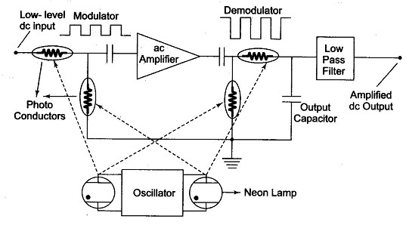
Technocrats Institute of Technology (Excellence), Bhopal
Chopper Type DC Voltmeter
Chopper Type DC Voltmeter

Slide 14
Technocrats Institute of Technology (Excellence), Bhopal
Working
A chopper amplifier is normally used for the first stage of amplification in very sensitive instruments of a few μV range.
It is passed through a blocking capacitor, amplified and then passed through another blocking capacitor, in order to remove the dc drift or offset of the amplified signal.
Photo diodes are used as non-mechanical choppers for modulation (conversion of dc to ac) and demodulation (conversion of ac to dc).
Photo conductors have a low resistance, ranging from a few hundreds to a few thousand ohms, when they are illuminated by a neon or incandescent lamp.
An oscillator drives two neon lamps into illumination on alternating half cycles of oscillation.
Each neon lamp illuminates one photo diode in the input circuit of the ampli­fier and one in the output circuit.
The input signal to the amplifier is a square wave whose amplitude is pro­portional to the input voltage with a frequency equal to the oscillators fre­quency.
The ac amplifier delivers an amplified square wave at its output termi­nals. The photo diodes (demodulator) in the output circuit operate in anti synchronously with the input chopper, recovering the dc signal by a demodulating action.
The dc output signal is then passed to a low pass filter to remove any residual ac component. This amplified drift free dc output is then applied to a PMMC movement for measurement.

Slide 15
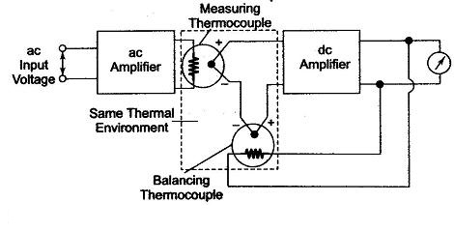
Technocrats Institute of Technology (Excellence), Bhopal
True RMS Voltmeter
Complex waveform are most accurately measured with an rms voltmeter. This instrument produces a meter indication by sensing waveform heating power, which is proportional to the square of the rms value of the voltage.
This heating power can be measured by amplifying and feeding it to a thermocouple, whose output voltages is then proportional to the E_{rms.}
The effect of non-linear behaviour of the thermocouple in the input circuit (measuring thermocouple) is cancelled by similar non-linear effects of the thermocouple in the feedback circuit (balancing thermocouple).

Slide 16
Technocrats Institute of Technology (Excellence), Bhopal
UNIT-II (CRO)
Electrostatic focusing
It consists of three anodes, with the middle anode at a lower potential than the other two electrodes.
In figure two anodes and its electrostatic lines and equipotential surfaces are shown.
Potential difference is kept between these two electrodes so that an electric field is generated between them. Spreading of electric field is caused because of repulsion between electric lines.
As know that electrons move in a direction opposite to that of electric field lines and equal-potential surfaces are perpendicular to the electric field lines so force on the electron is exerted in the direction normal to the equipotential surface.

Slide 17
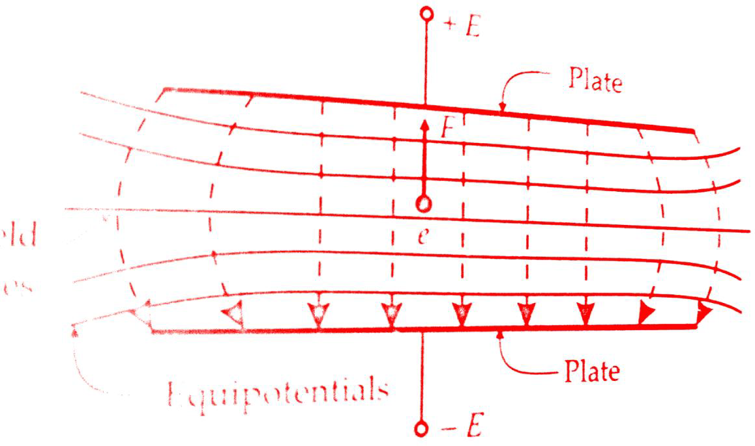
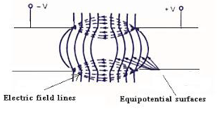
Technocrats Institute of Technology (Excellence), Bhopal

Slide 18
Technocrats Institute of Technology (Excellence), Bhopal
An equi-potential surface is shown, in which an electron with velocity V1 and at an angle θ. to the normal of equi-potential surface enters and experiences a force in a direction normal to the equi-potential surface.
Thus the velocity of the electron increases to V2. This force on the electron is exerted in the direction normal to equi-potential surface so only the normal component of electron velocity V1N increases to V2N and the tangential component of velocity V1T remains the same.
Force on the electron is,
F = -eε N
Where ε = electric field intensity ; V/m
e = charge of electron = 1.602 ×10⁻¹⁹ C
V1T = V1 sin θ1,
V2T = V2 sin θ2
But V1T = V2T
V1 sin θ1 = V2 sin θ2 or V2/V1 = sin θ1 / sin θ2

Slide 19
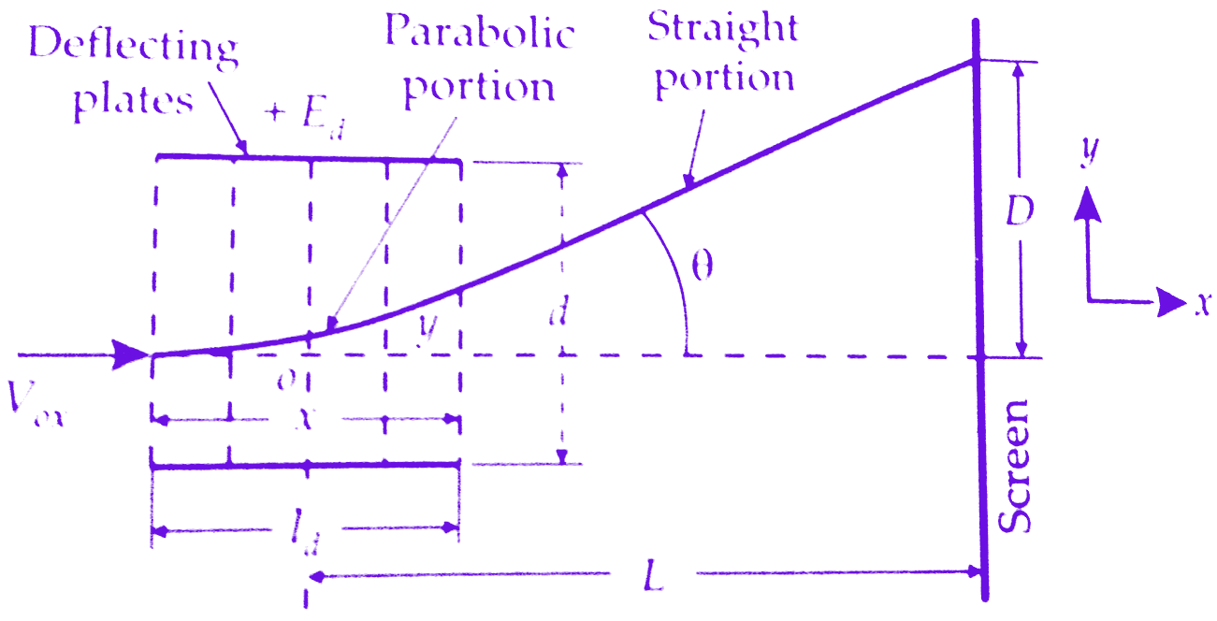
Technocrats Institute of Technology (Excellence), Bhopal
Electrostatic deflection
The figure below shows a general arrangement for electrostatic deflection in CRO. There are two parallel plates with a potential applied between.
These plates produced a uniform an electrostatic field in the Y direction. Thus any electron entering the field will experience a force in the Y direction and will be accelerated in that direction.
There is no force either in X direction or Z direction and hence there will be no acceleration of electrons in these directions. Now we will derive the equation of electrostatic deflection in CRT tube.

Slide 20
Technocrats Institute of Technology (Excellence), Bhopal
As the velocity in X direction is constant, the displacement in X direction is given by,
x = Vox.t
t = x/Vox
Submitting the above value t;
y = (½) (eεy/m)(x/Vox)²
This is the equation of a parabola. The slope at any point (x,y) is
dy/dx = eεy/mV²ox Put x = ld in above equation we get the value of .
Tan θ = (eεy/mV²ox).ld = (e.Ed.ld)/mdV²ox
After leaving the Electrostatic deflection plates, electrons travel in a straight line. The straight line of travel of electrons is tangent to the parabola at x=ld and this tangent intersects the X-axis at point O.The location of this point is given by,
x = y/tan θ = (eεy/2mV²ox).l²d/(eεy/mV²ox).ld = ld/2
The Apparent origin is thus at the centre of deflection plates.The deflection D on the screen is given by,
D = L tan θ = L. (e.Ed.ld)/mdV²ox
Substituting the value of V²ox = 2eEa/m in above equation,we get
D = L. (e.Ed.ld)/md × m/2eEa = L.Ed.ld/2dEa

Slide 21
Technocrats Institute of Technology (Excellence), Bhopal
AC Bridges
Definition: AC bridges are the circuits that are used for the measurement of electrical quantities such as inductance, capacitance, resistance.
Along with these an ac bridge allows us to measure storage factor, loss factor, dissipation factor etc. AC bridges operate with only AC signal.
The AC bridges are very convenient and give the accurate result of the measurement.

Slide 22
Technocrats Institute of Technology (Excellence), Bhopal
Maxwell’s bridge (Inductance and Inductance-Capacitance)
In this bridge arrangement the value of unknown inductance is measured by comparison with a variable standard self-inductance.
Two branches bc and cd consist of non-inductive resistance R3 and R4.
One of the arms ad consists of variable inductance L2 of fixed internal resistance r2 connected in series with variable resistance R2. The remaining arm ab consists of unknown inductance Lx of resistance Rx.
A source of current is applied to two opposite junctions across ac and a null detector is connected to the other two junction’s b and d.

Slide 23
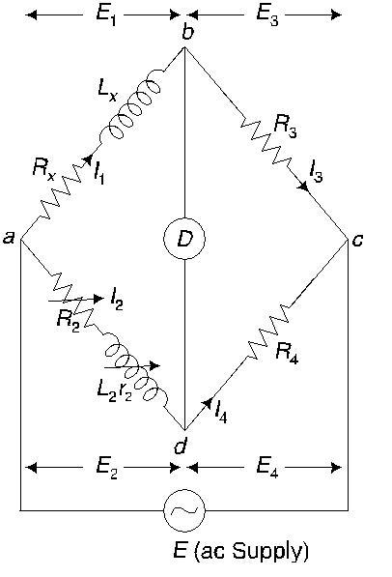
Technocrats Institute of Technology (Excellence), Bhopal

Slide 24
Technocrats Institute of Technology (Excellence), Bhopal
Hay’s Bridge
The Hay’s bridge is modification of the Maxwell’s bridge. The connection diagram of the Hay’s bridge is shown in figure below.
This Hay’s bridge uses a resistor in series with a standard capacitor (unlike the Maxwell’s bridge which uses a resistance in parallel with the capacitor).
It also used to measurement of unknown inductance by comparison with a variable standard self-inductance

Slide 25
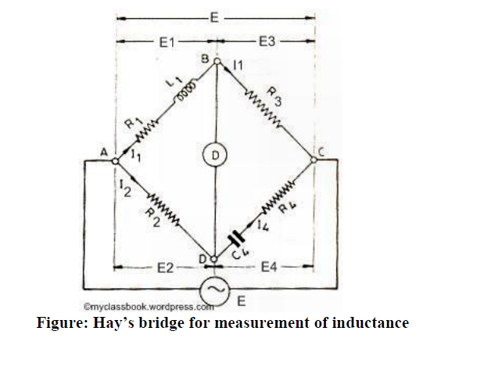
Technocrats Institute of Technology (Excellence), Bhopal

Slide 26
Technocrats Institute of Technology (Excellence), Bhopal
UNIT-III
Classification of Transducers
1. on the basis of transduction principle used.
2. Active and passive transducers.
3. Analog and digital transducers.
4. Primary and secondary transducers.
5. Transducers and inverse transducers.

Slide 27
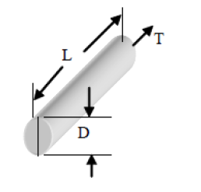
Technocrats Institute of Technology (Excellence), Bhopal
Strain gauge
The stress generates changes in the dimensions of the bar as shown in Figure. The fractional change in length is defined as the strain. .
The change in the direction of the force is called the axial strain = dL/L (μm/m)
Dimension of strain is unity, i.e. strain is dimensionless.

Slide 28
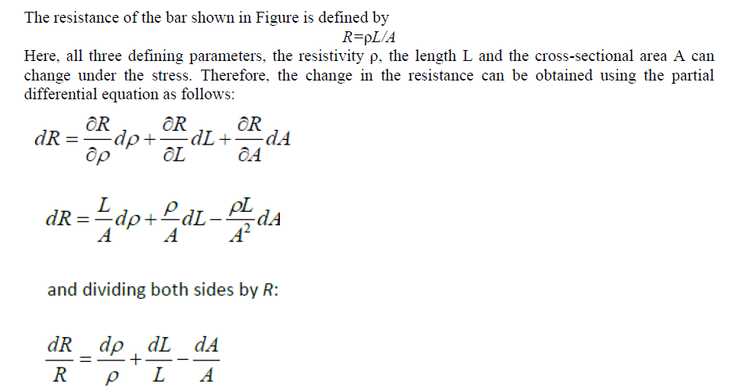
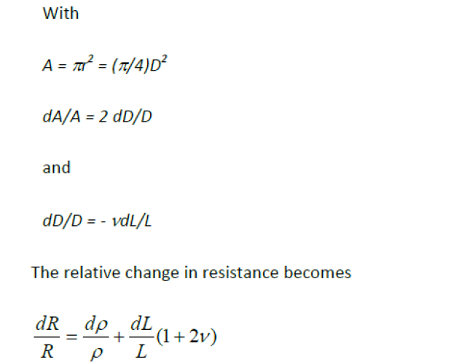
Technocrats Institute of Technology (Excellence), Bhopal

Slide 29
Technocrats Institute of Technology (Excellence), Bhopal
LVDT (Linear Variable Differential Transformer)
LVDT works on the principle of variation of mutual inductance. It is one of the most popular types of displacement sensor. It has good linearity over a wide range.
It consists of a primary winding and two identical secondary windings of a transformer, wound over a tubular former, and a ferromagnetic core of annealed nickel-iron alloy moves through the former.
The two secondary windings are connected in series opposition, so that the net output voltage is the difference between the two.
The primary winding is excited by 1-10V r.m.s. A.C. voltage source, the frequency of excitation may be anywhere in the range of 50 Hz to 50 KHz.
The output voltage is zero when the core is at central position (voltage induced in both the secondary windings are same, so the difference is zero), but increasing as the core moves away from the central position, in either direction.

Slide 30
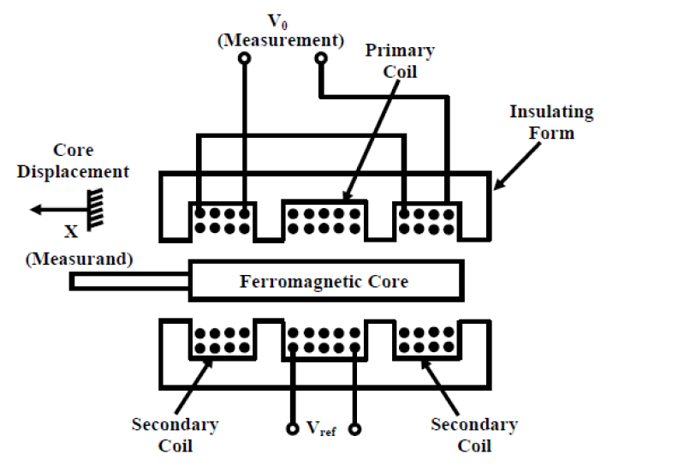
Technocrats Institute of Technology (Excellence), Bhopal

