Slide 1
DELD
EC 303 Digital System Design

Slide 2
Technocrats Institute of Technology (Excellence), Bhopal
SYLLABUS CONTENT-
Registers and Counters : Asynchronous and Synchronous counter, counters with MOD numbers, Down counter, UP/DOWN counter, propagation delay in ripple counter, programmable counter, Pre- settable counter, BCD counter, cascading, counter applications,Decoding in counter, Decoding glitches, Ring Counter, Johnson counter, Rotate left & Rotate right counter, Registers – Buffer, Shift left, shift right, shift left/Right registers, parallel in parallel out, serial in serial out, parallel in serial out, serial in parallel out registers.
www.technocratsgroup.edu.in

Slide 3
Technocrats Institute of Technology (Excellence), Bhopal
Shift Register is a group of flip flops used to store multiple bits of data. The bits stored in such registers can be made to move within the registers and in/out of the registers by applying clock pulses. An n-bit shift register can be formed by connecting n flip-flops where each flip flop stores a single bit of data
Use : Shift Registers are used for data storage or for the movement of data and are therefore commonly used inside calculators or computers to store data such as two binary numbers before they are added together, or to convert the data from either a serial to parallel or parallel to serial format
www.technocratsgroup.edu.in

Slide 4
Technocrats Institute of Technology (Excellence), Bhopal
Types of shift registers :
Following are the four types of shift registers based on applying inputs and accessing of outputs.
Serial In − Serial Out shift register.
Serial In − Parallel Out shift register.
Parallel In − Serial Out shift register.
Parallel In − Parallel Out shift register.
www.technocratsgroup.edu.in

Slide 5
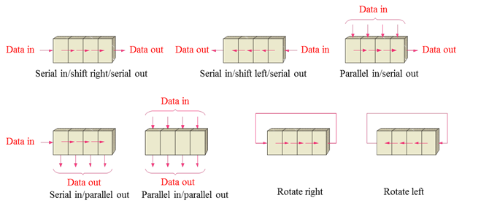
Technocrats Institute of Technology (Excellence), Bhopal

Slide 6
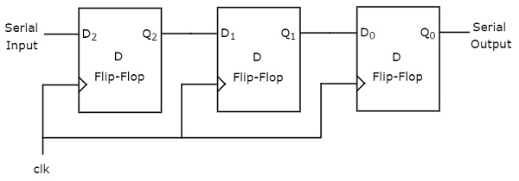
Technocrats Institute of Technology (Excellence), Bhopal
serial in serial out shift register
Serial In Serial Out (SISO) shift registers are a kind of shift registers where both data loading as well as data retrieval to/from the shift register occurs in serial-mode.
www.technocratsgroup.edu.in

Slide 7
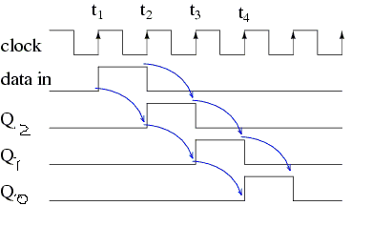
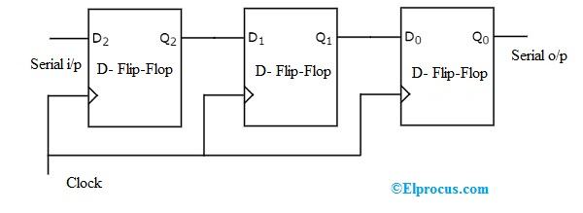
Technocrats Institute of Technology (Excellence), Bhopal
Serial In Serial Out (SISO) shift registers are a kind of shift registers where both data loading as well as data retrieval to/from the shift register occurs in serial-mode
www.technocratsgroup.edu.in

Slide 8
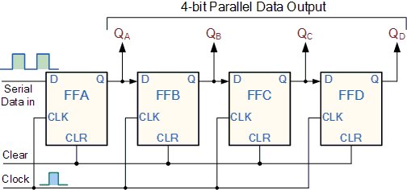
Technocrats Institute of Technology (Excellence), Bhopal
.
4-bit Serial-in to Parallel-out Shift Register:
The serial-in parallel-out shift register is used to convert serial data into parallel data thus they are used in communication lines where demultiplexing of a data line into several parallel line is required In Serial In Parallel Out (SIPO) shift registers, the data is stored into the register serially while it is retrieved from it in parallel-fashion.
www.technocratsgroup.edu.in

Slide 9
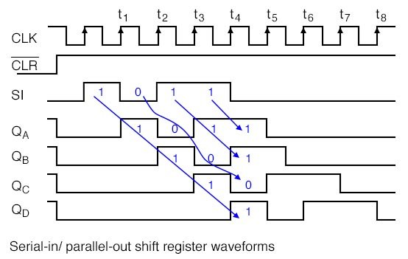
Technocrats Institute of Technology (Excellence), Bhopal
www.technocratsgroup.edu.in

Slide 10
Technocrats Institute of Technology (Excellence), Bhopal
Parallel-in to Serial-out (PISO) - the parallel data is loaded into the register simultaneously and is shifted out of the register serially one bit at a time under clock control.
www.technocratsgroup.edu.in

Slide 11
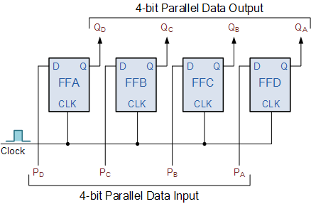
Technocrats Institute of Technology (Excellence), Bhopal
shift register parallel in parallel out
www.technocratsgroup.edu.in

Slide 12
Technocrats Institute of Technology (Excellence), Bhopal
Counter is a sequential circuit. IA digital circuit which is used for a counting pulses is known as counter. Counter is the widest application of flip-flops.
Counters types, namely,
(i)synchronous
ii)Asynchronous, counter.
These further can be subdivided into
Up/Down Counter and such like.
MOD Counter
Ring Counter,
Johnson Counter,
www.technocratsgroup.edu.in

Slide 13
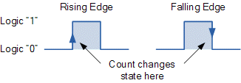
Technocrats Institute of Technology (Excellence), Bhopal
Synchronous counters:
Synchronous counters are easier to design than asynchronous counters.
They are called synchronous counters because the clock input of the flip-flops. are all clocked together at the same time with the same clock signal. Due to this common clock pulse all output states switch or change simultaneously.
Synchronous Counters are so called because the clock input of all the individual flip-flops within the counter are all clocked together at the same time by the same clock signal
www.technocratsgroup.edu.in

Slide 14
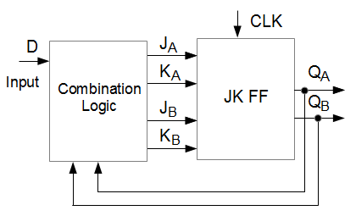
Technocrats Institute of Technology (Excellence), Bhopal
SYNCHRONOUS COUNTER DESIGN STEPS/PROCEDURES.
Determine the No. of FFs needed to support the counting sequence's.
highest No..
2^{n} -1 ≥ Highest No.
Build a State Transition Diagram.
Build a State/Excitation Truth Table.
Simplify expressions for FF inputs for each F/F on K-Maps.
www.technocratsgroup.edu.in

Slide 15
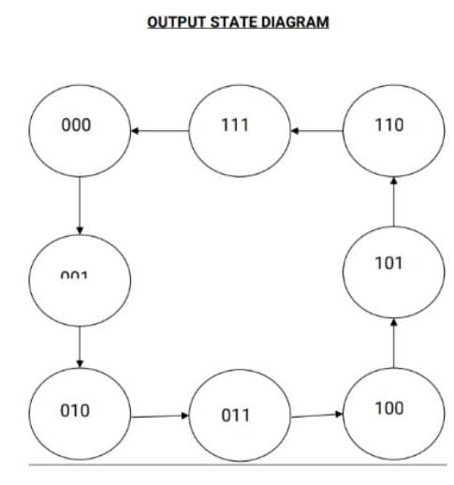
Technocrats Institute of Technology (Excellence), Bhopal
3 Bit SYNCHRONOUS COUNTER DESIGN:
3 Bit can count 000 to 2^{n} -1
Count Sequence 000-111
No. Of Flip Flop = n
Taking T FF for designing
Consider Excitation Table of TT FF
www.technocratsgroup.edu.in

Slide 16
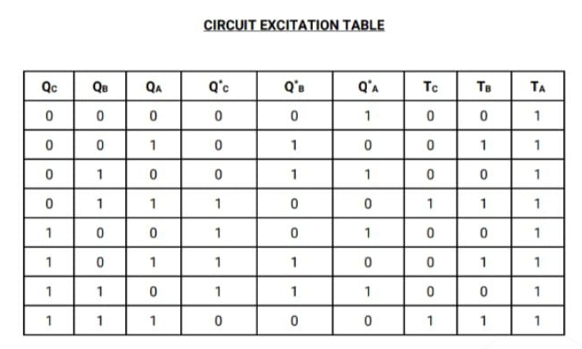
Technocrats Institute of Technology (Excellence), Bhopal
www.technocratsgroup.edu.in

Slide 17
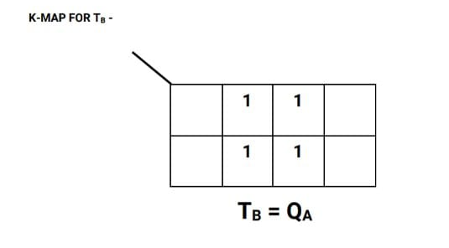
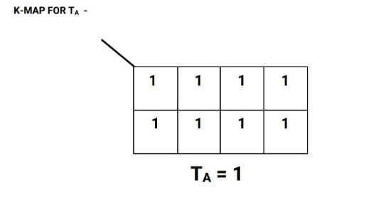
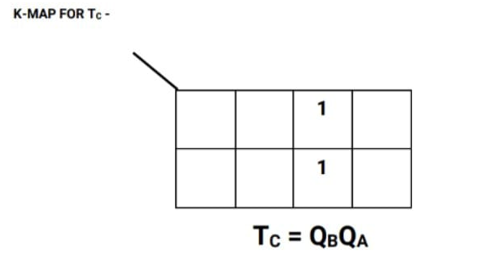
Technocrats Institute of Technology (Excellence), Bhopal
www.technocratsgroup.edu.in

Slide 18
www.technocratsgroup.edu.in

Slide 19
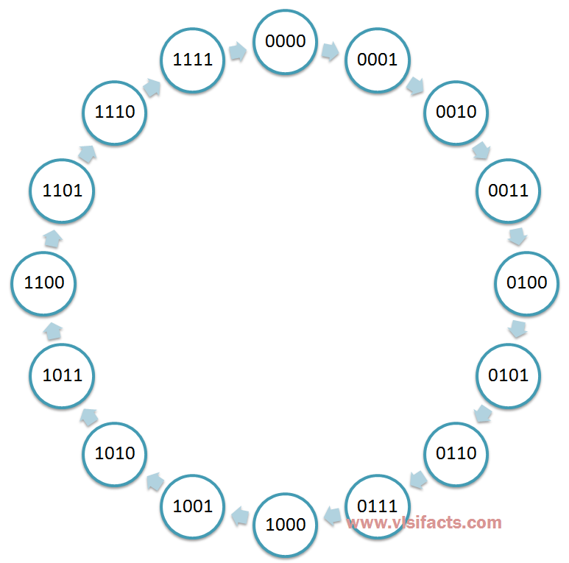
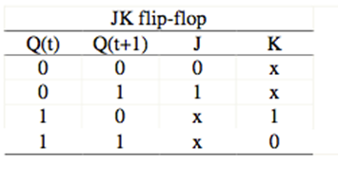
Technocrats Institute of Technology (Excellence), Bhopal
4 Bit SYNCHRONOUS UP COUNTER DESIGN using J K FF :
Total States= 16
Count From 0000-1111 0-2^{n} -1(0- -15)
Highest No. 15
2 ^{n} >0r = N (no. of states 16)
n-=4
No. Of FF Required 4
Select Type o FF-JK FF
Make Excitation Table
www.technocratsgroup.edu.in

Slide 20
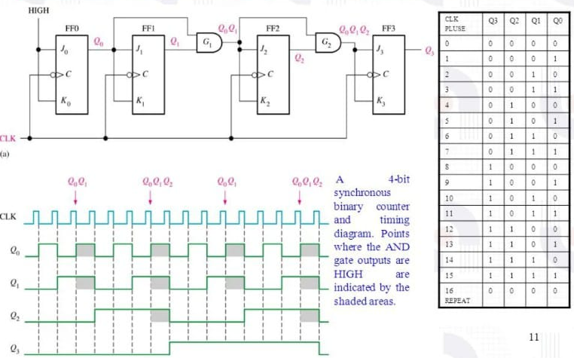
Technocrats Institute of Technology (Excellence), Bhopal
Analysis of 4 Bit SYNCHRONOUS UP COUNTER using J K FF :
www.technocratsgroup.edu.in

Slide 21
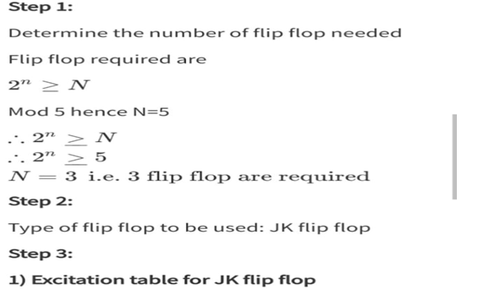
Technocrats Institute of Technology (Excellence), Bhopal
DESIGN OF MOD Counter using J K FF : MOD 5 Counter
www.technocratsgroup.edu.in

Slide 22
Technocrats Institute of Technology (Excellence), Bhopal
Counter Table
QC | QB | QA | QC+ | QB+ | QA+ | Jc | Kc | JB | KB | JA | KA
0 | 0 | 0 | 0 | 0 | 1 | 0 | x | 0 | x | 1 | x
0 | 0 | 1 | 0 | 1 | 0 | 0 | x | 1 | x | x | 1
0 | 1 | 0 | 0 | 1 | 1 | 0 | x | x | 0 | 1 | X
0 | 1 | 1 | 1 | 0 | 0 | 1 | x | 1 | x | x | 1
1 | 0 | 0 | 0 | 0 | 0 | x | 1 | 0 | x | 1 | x
1 | 0 | 1 | x | x | x | x | x | x | x | x | x
1 | 1 | 0 | x | x | x | x | x | x | x | x | x
1 | 1 | 1 | x | x | x | x | x | x | x | x | x
www.technocratsgroup.edu.in

Slide 23
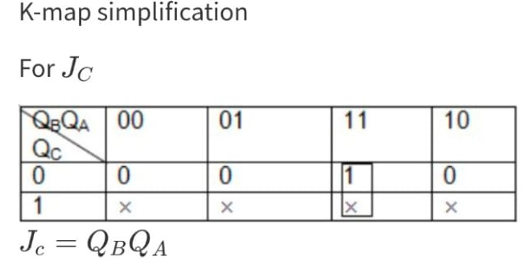
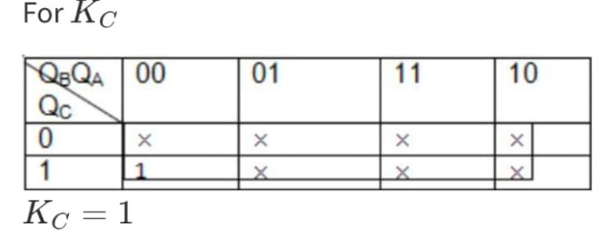
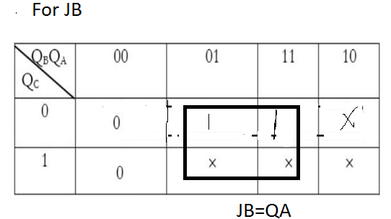
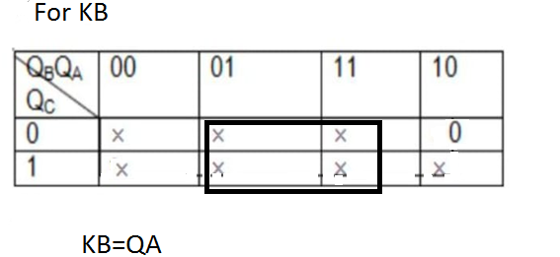
Technocrats Institute of Technology (Excellence), Bhopal
www.technocratsgroup.edu.in

Slide 24
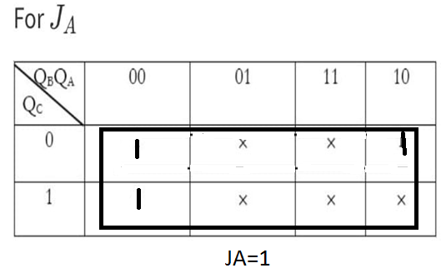
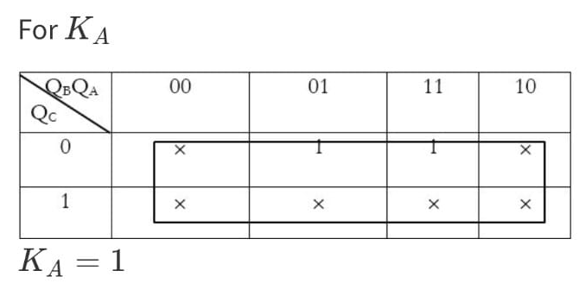
Technocrats Institute of Technology (Excellence), Bhopal
www.technocratsgroup.edu.in

Slide 25
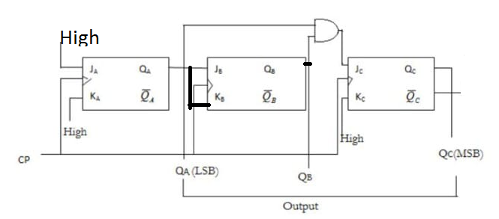
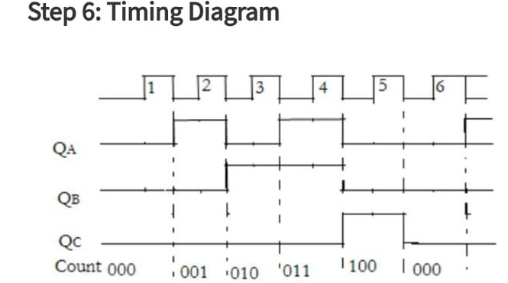
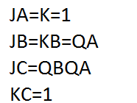
Technocrats Institute of Technology (Excellence), Bhopal
www.technocratsgroup.edu.in

Slide 26
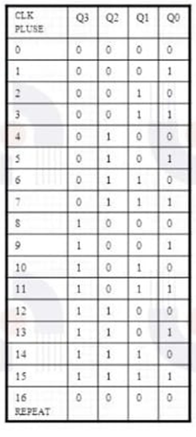
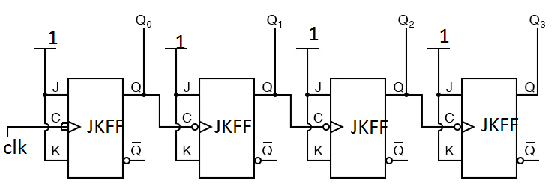
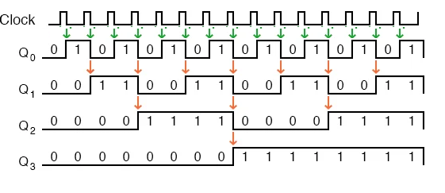
Technocrats Institute of Technology (Excellence), Bhopal
4 Bit Asynchronous UP Counter
J=k=1, Negative Edge Triggering and take output from Q,
Remaining FF CLK from previous FF Q
www.technocratsgroup.edu.in

Slide 27
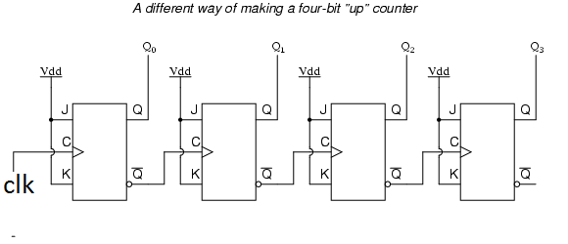
Technocrats Institute of Technology (Excellence), Bhopal
4 Bit Asynchronous UP Counter:
J=k=1, Positive Edge Triggering and take output from Q, Remaining FF CLK from previous FF Q’
www.technocratsgroup.edu.in

Slide 28
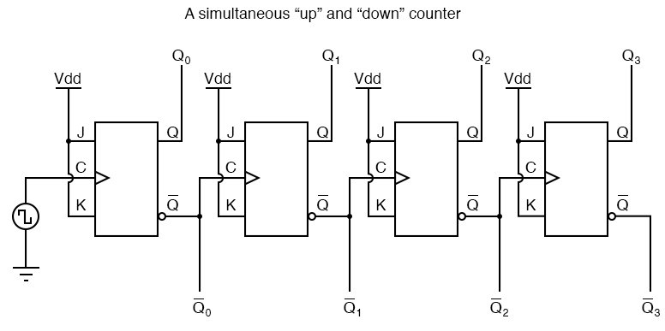
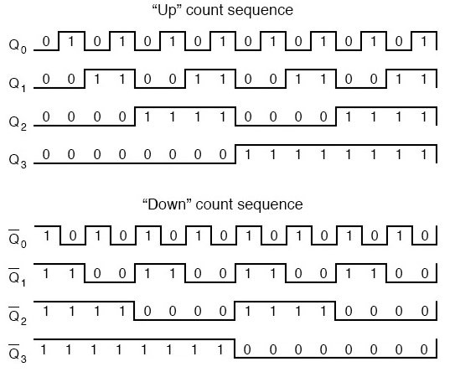
Technocrats Institute of Technology (Excellence), Bhopal
Asynchronous UP and Down Counter:
www.technocratsgroup.edu.in

Slide 29
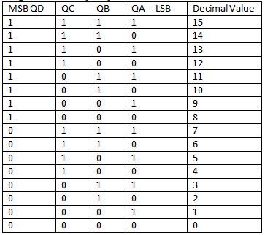
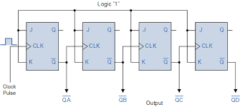
Technocrats Institute of Technology (Excellence), Bhopal
4 Bit ASYNCHRONOUS DOWN COUNTER DESIGN using J K FF :
www.technocratsgroup.edu.in

Slide 30
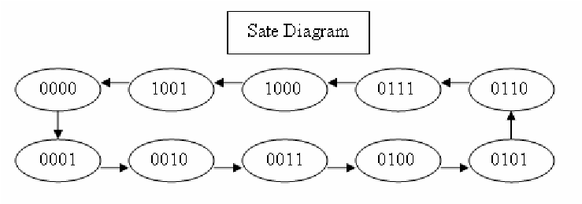
Technocrats Institute of Technology (Excellence), Bhopal
BCD counters: It follow a sequence of ten states and count using BCD numbers from 0000 to 1001 and then returns to 0000 and repeats. Such a counter must have at least four flip-flops to represent each decimal digit, since a decimal digit is represented by a binary code with at least four bits giving a MOD-10 count.
It is also known as Decade counter
www.technocratsgroup.edu.in

Slide 31
Technocrats Institute of Technology (Excellence), Bhopal
A | B | C | D | A+ | B+ | C+ | D+ | JA | KA | JB | KB | JC | KC | JD | KD
0 | 0 | 0 | 0 | 0 | 0 | 0 | 1 | 0 | X | 0 | X | 0 | X | 1 | X
0 | 0 | 0 | 1 | 0 | 0 | 1 | 0 | 0 | X | 0 | X | 1 | X | X | 1
0 | 0 | 1 | 0 | 0 | 0 | 1 | 1 | 0 | X | 0 | X | X | 0 | 1 | X
0 | 0 | 1 | 1 | 0 | 1 | 0 | 0 | 0 | X | 1 | X | X | 1 | X | 1
0 | 1 | 0 | 0 | 0 | 1 | 0 | 1 | 0 | X | X | 0 | 0 | X | 1 | X
0 | 1 | 0 | 1 | 0 | 1 | 1 | 0 | 0 | X | X | 0 | 1 | X | X | 1
0 | 1 | 1 | 0 | 0 | 1 | 1 | 1 | 0 | X | X | 0 | X | 0 | 1 | X
0 | 1 | 1 | 1 | 1 | 0 | 0 | 0 | 1 | X | X | 1 | X | 1 | X | 1
1 | 0 | 0 | 0 | 1 | 0 | 0 | 1 | X | 0 | 0 | X | 0 | X | 1 | X
1 | 0 | 0 | 1 | 0 | 0 | 0 | 0 | X | 1 | 0 | X | 0 | X | X | 1
www.technocratsgroup.edu.in

Slide 32
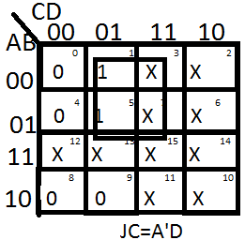
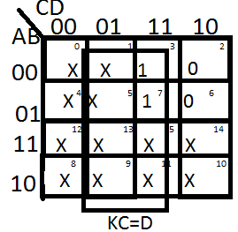
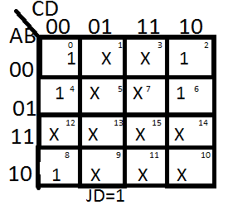
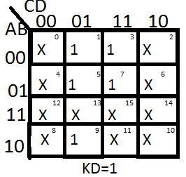
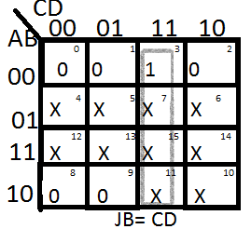
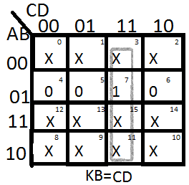
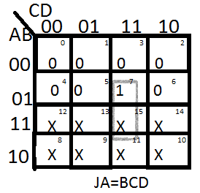
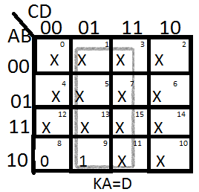
www.technocratsgroup.edu.in

Slide 33
Technocrats Institute of Technology (Excellence), Bhopal
www.technocratsgroup.edu.in

Slide 34
Technocrats Institute of Technology (Excellence), Bhopal
BCD counters: It follow a sequence of ten states and count using BCD numbers from 0000 to 1001 and then returns to 0000 and repeats. Such a counter must have at least four flip-flops to represent each decimal digit, since a decimal digit is represented by a binary code with at least four bits giving a MOD-10 count.
It is also known as Decade counter
www.technocratsgroup.edu.in

Slide 35
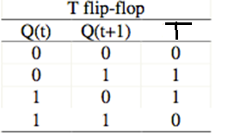
Technocrats Institute of Technology (Excellence), Bhopal
A | B | C | D | A+ | B+ | C+ | D+ | TA | TB | TC | TD
0 | 0 | 0 | 0 | 0 | 0 | 0 | 1 | 0 | 0 | 0 | 1
0 | 0 | 0 | 1 | 0 | 0 | 1 | 0 | 0 | 0 | 1 | 1
0 | 0 | 1 | 0 | 0 | 0 | 1 | 1 | 0 | 0 | 0 | 1
0 | 0 | 1 | 1 | 0 | 1 | 0 | 0 | 0 | 1 | 1 | 1
0 | 1 | 0 | 0 | 0 | 1 | 0 | 1 | 0 | 0 | 0 | 1
0 | 1 | 0 | 1 | 0 | 1 | 1 | 0 | 0 | 0 | 1 | 1
0 | 1 | 1 | 0 | 0 | 1 | 1 | 1 | 0 | 0 | 0 | 1
0 | 1 | 1 | 1 | 1 | 0 | 0 | 0 | 1 | 1 | 1 | 1
1 | 0 | 0 | 0 | 1 | 0 | 0 | 1 | 0 | 0 | 0 | 1
1 | 0 | 0 | 1 | 0 | 0 | 0 | 0 | 1 | 0 | 0 | 1
www.technocratsgroup.edu.in

Slide 36
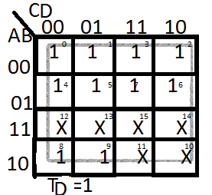
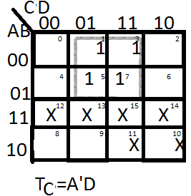
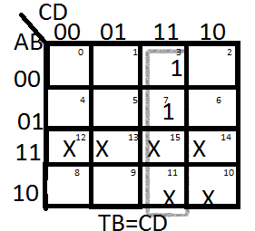
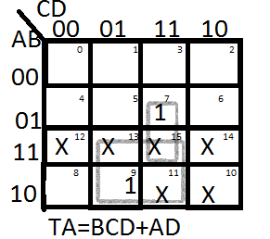
Technocrats Institute of Technology (Excellence), Bhopal
www.technocratsgroup.edu.in

Slide 37
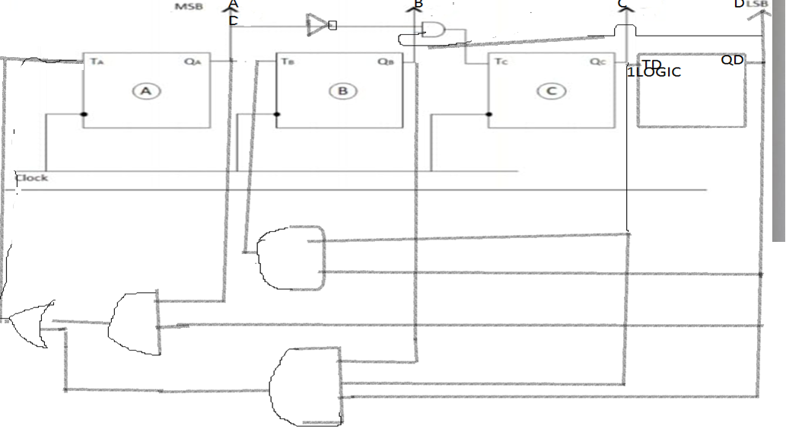
Technocrats Institute of Technology (Excellence), Bhopal
www.technocratsgroup.edu.in

Slide 38
Technocrats Institute of Technology (Excellence), Bhopal
Ring Counter: It is synchronous counter, Circular Shift Register
It is a type of counter composed of flip-flops connected into a shift register, with the output of the last flip-flop fed to the input of the first, making a "circular" or "ring" structure.
www.technocratsgroup.edu.in

Slide 39
Technocrats Institute of Technology (Excellence), Bhopal
Johnson Counter:
Johnson counter also known as creeping counter, is an example of synchronous counter. In Johnson counter, the complemented output of last flip flop is connected to input of first flip flop and to implement n-bit Johnson counter we require n flip-flop.It is one of the most important type of shift register counter. It provides 2k states and provide special timing sequence
www.technocratsgroup.edu.in

Slide 40
Technocrats Institute of Technology (Excellence), Bhopal
Design synchronous counter using JK FF that follow the sequence
000, 101, 110, 111, 011, 010, 000
www.technocratsgroup.edu.in

Slide 41
Technocrats Institute of Technology (Excellence), Bhopal
www.technocratsgroup.edu.in

Slide 42
Technocrats Institute of Technology (Excellence), Bhopal
www.technocratsgroup.edu.in

Slide 43
Technocrats Institute of Technology (Excellence), Bhopal
Glitches in Ripple Counter/Asynchronous Counters
When designing asynchronous circuits it can happen that you get spikes (glitches) on the signal values •
This is due to the presence of several signalling paths which have different delay times.
There is a short delay between an input logic level changing and the corresponding output change.
Glitches in digital circuits are unnecessary transitions due to varying path delays in the circuit.
Balanced path delay techniques can be used for resolving differing path delays. To make path delays equal, buffer insertion is done on the faster paths. Balanced path delay will avoid glitches in the output.
In Fig. spurious 0 is called a glitch.
www.technocratsgroup.edu.in

Slide 44
Technocrats Institute of Technology (Excellence), Bhopal
Decoding Error in Ripple Counter/Asynchronous Counters
Due to glitch occurs in asynchronous counters false 1 or 0 occurs that may result in decoding error.
1/F= T=n+TP+TCLK
Where n= No. Of FF
TP= Propagation Delay of One FF
Tclk =Clock time
Delay in timing of transition causes decoding error
www.technocratsgroup.edu.in

Slide 45
Technocrats Institute of Technology (Excellence), Bhopal
Frequency Division:
A Divide by N counter implies that it divides the input clock frequency by N (i.e N=2^{n} )
If you cascade four flip-flops then, the output of every stage is divided by 2, if output is taken from the 4th flip-flop, then its output frequency is clock frequency divided by 16 (fclock/2^4).
www.technocratsgroup.edu.in

Slide 46
Technocrats Institute of Technology (Excellence), Bhopal
www.technocratsgroup.edu.in

Slide 47
Technocrats Institute of Technology (Excellence), Bhopal
Difference between Synchronous and Asynchronous Counter
In synchronous counter, all flip flops are triggered with same clock simultaneously. | In asynchronous counter, different flip flops are triggered with different clock, not simultaneously.
Synchronous Counter is faster than asynchronous counter in operation. | Asynchronous Counter is slower than synchronous counter in operation.
Synchronous Counter does not produce any decoding errors. | Asynchronous Counter produces decoding error.
Synchronous Counter is also called Parallel Counter. | Asynchronous Counter is also called Serial Counter.
In synchronous counter, propagation delay is less. | In asynchronous counter, there is high propagation delay.
Synchronous Counter examples are: Ring counter, Johnson counter. | Asynchronous Counter examples are: Ripple UP counter, Ripple DOWN counter.
www.technocratsgroup.edu.in

Slide 48
Any Query ?
Technocrats Institute of Technology (Excellence), Bhopal
THANKYOU
www.technocratsgroup.edu.in

Slide 49
Technocrats Institute of Technology (Excellence), Bhopal
JA=
KB=
JA=
KB=
JC=
KC=
JD=
KD=
www.technocratsgroup.edu.in

